Slide 1
The National FAA Safety Team Presents
Topic of the Month - October
Human Performance
Notes:
2024/09-10-314(I)PP Original Author: John Steuernagle; POC Kevin Clover, National FAASTeam Program Manager (Operations), Office 562-888-2020.
Presentation note: This is the title slide for FY2026 Topic of the Month – October – Human Performance.
Script - We have included a script of suggested dialog with most slides. The script will always appear in a non-italic font. Presenters may read the script or modify it to suit their own presentation style. See template slides 3 and 4 for examples of a slides with script.
Presentation Instructions - (stage direction and presentation suggestions) will be preceded by a Bold header: the instructions themselves will be in Italic fonts. See slides 2 for an example of slides with Presentation Instructions only.
Program control instructions - will be in bold fonts and look like this: (Click) for building information within a slide; or this: (Next Slide) for slide advance.
Background information - Some slides may contain background information that supports the concepts presented in the program. Background information will always appear last and will be preceded by a bold Background: identification.
The production team hope you and your audience will enjoy the show. Break a leg!
(Next Slide)

Slide 2
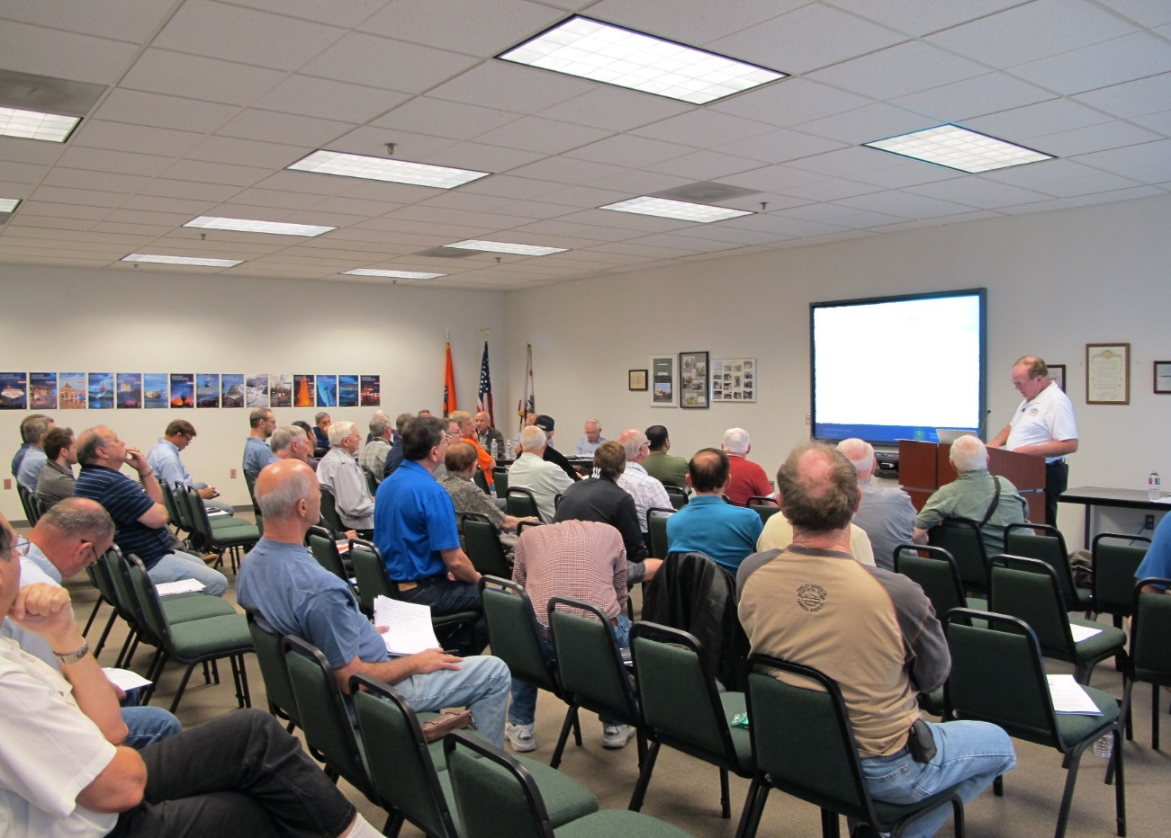

Welcome
Exits
Restrooms
Emergency Evacuation
Breaks
Silence Phones & Devices
Sponsor Acknowledgment
Other
Notes:
Presentation Note: Here’s where you can discuss venue logistics, acknowledge sponsors, and deliver other information you want your audience to know in the beginning.
You can add slides after this one to fit your situation.
(Next Slide)

Slide 3
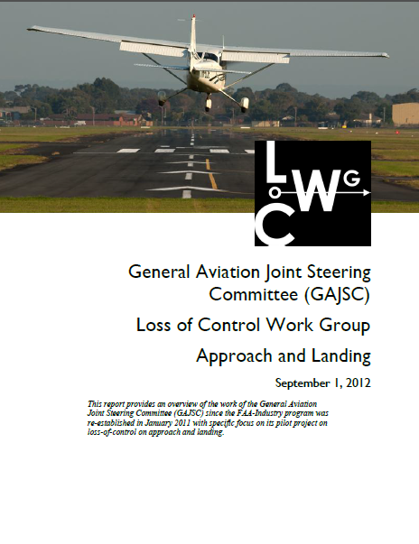
Overview
General Aviation Joint Safety Committee (GAJSC) & FAA Accident Study Findings
Human Factors Issues
Human Performance
Human Factors courses on FAASafety.gov
Notes:
In this presentation we’ll talk a little bit about recent GAJSC and FAA studies that deal with Human Factors identified in a selection of general aviation accident investigations. We’ll take a high-level view of human performance issues that may affect our piloting performance. And we’ll point you to a series of courses on FAASafety.gov where you can learn more.
Presentation Note: If you’ll be discussing additional items, add them to this list.
(Next Slide)

Slide 4
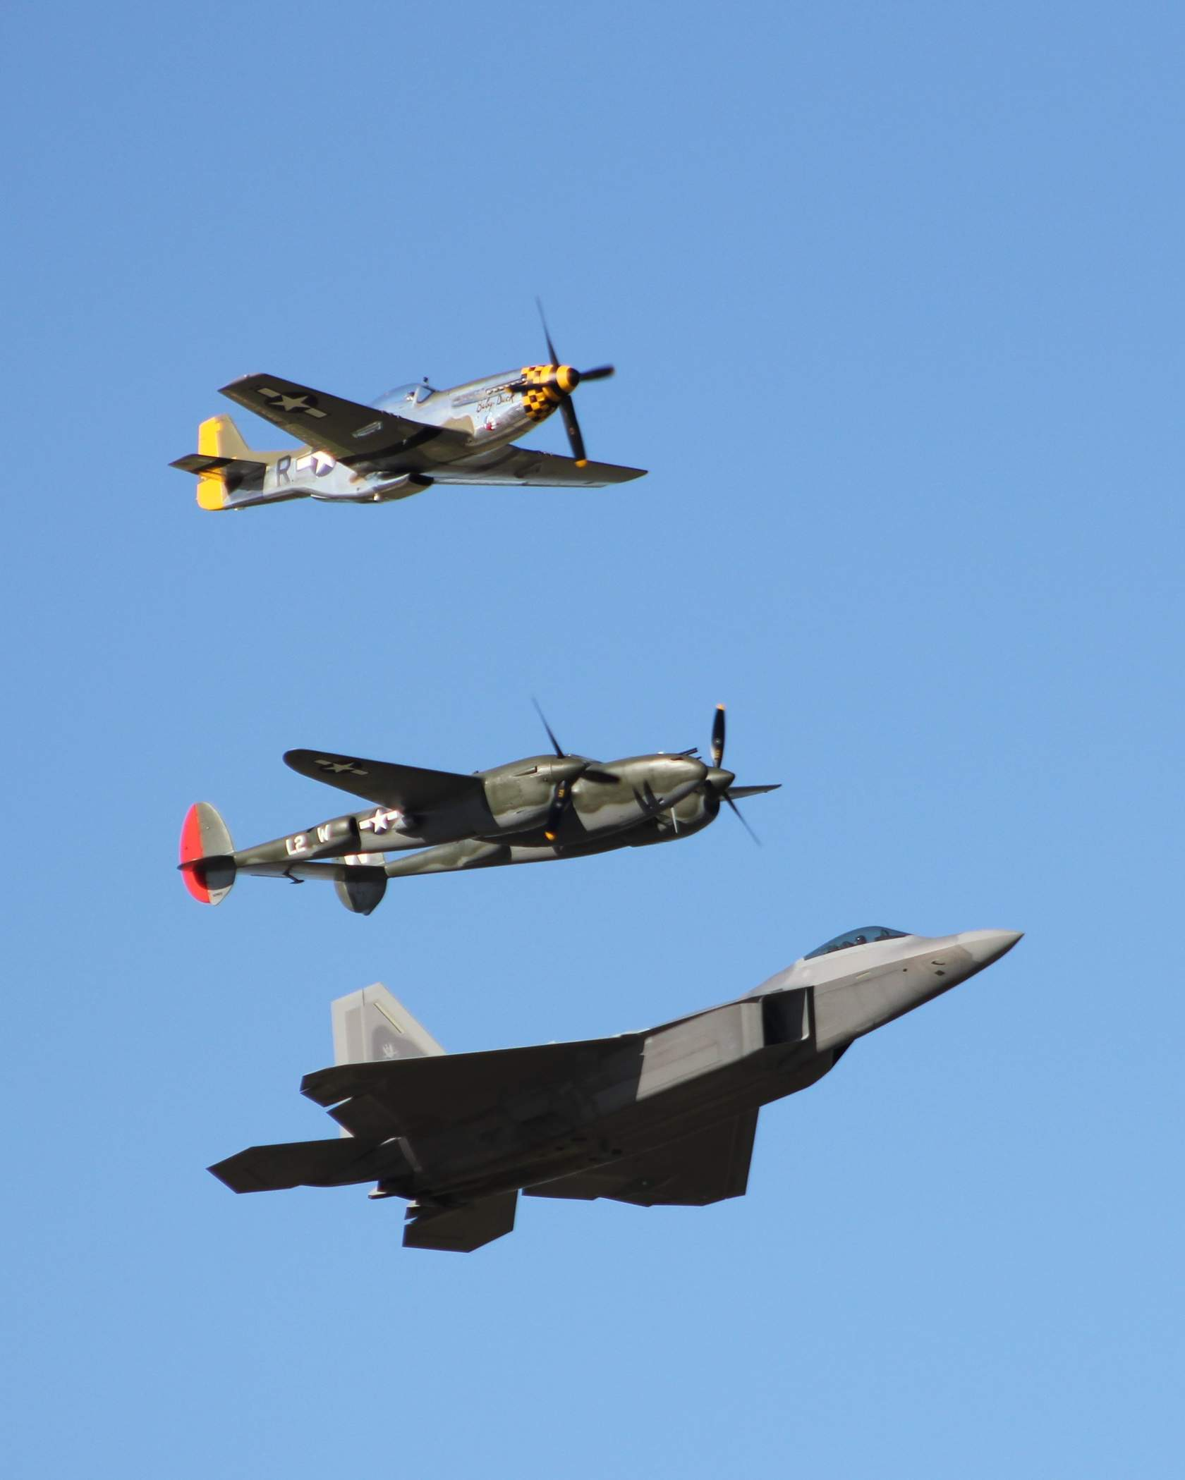
Celebrating more than a century of progress
Not just aircraft…
Notes:
For more than a century, we've been producing and flying powered aircraft. Each new design flies more payload farther, faster, and more efficiently than those that have gone before. Few human endeavors have yielded such profound results so quickly. (Click)
But that progress isn’t limited to aircraft.
(Next Slide)

Slide 5
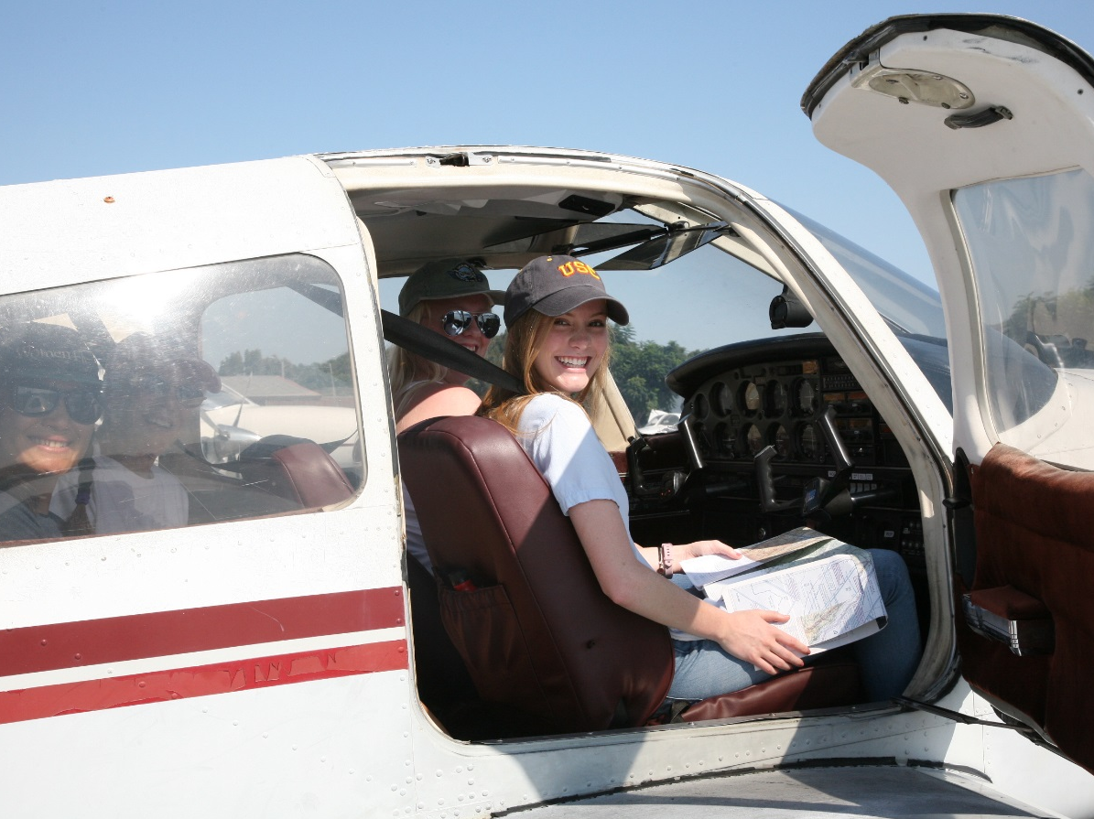
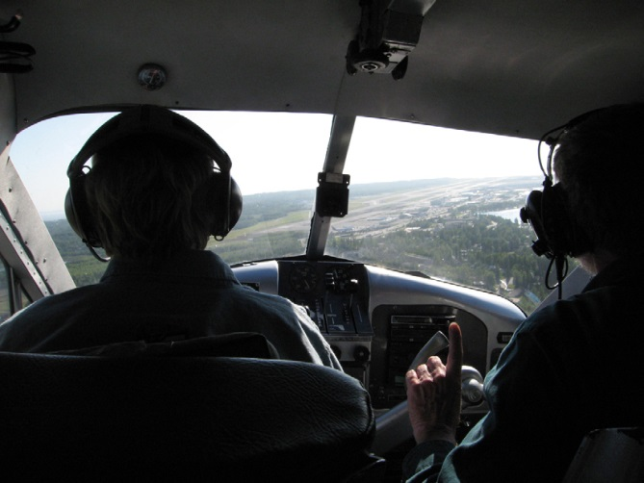
We’ve been busy with pilots too.
Human factors study – applies knowledge of the human body and mind to understand human capabilities and limitations.
Notes:
We've been busy with pilots too. Human Factors knowledge has shown us how to excel in dealing with the physical, intellectual, and emotional challenges of flight.
(Next Slide)

Slide 6
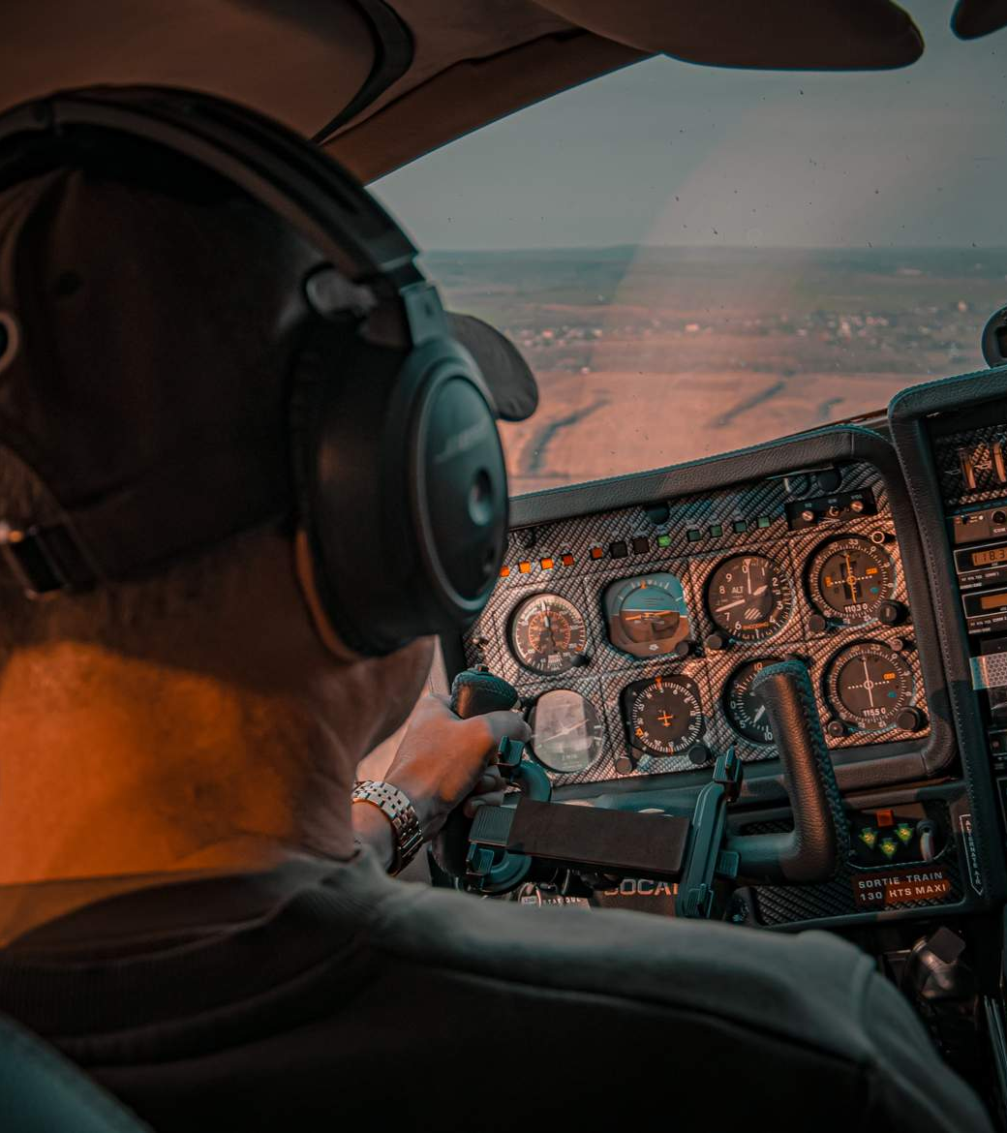
Fatigue
Stress
High Workload
Staying Healthy
Effective management is key to success.
Notes:
Fatigue, stress, high workload and struggling to stay healthy are constant issues for pilots. Depending on how they are managed, they can be a simple daily challenge or an overwhelming problem that adversely affects performance. (Click)
Let’s see what the Human Performance training module has to say. We won’t have time to cover everything of course but we’ll hit some of the highlights starting with fatigue.
(Next Slide)

Slide 7

Fatigue
Judgement errors
Forgetfulness
Sleepiness and/or yawning
Loss of appetite
Irritability
Imprecise flying
Notes:
We must be well rested to perform at our best. For most adults that means 7 to 9 hours of uninterrupted sleep each night.
Professional pilots often cite work schedules and commuting requirements as reasons why they are fatigued. Private pilots must also fit their flying into daily work and family schedules. That means they are often tempted to rise early or fly after work. Either way they may not be adequately rested before taking flight. (Click)
Without adequate rest we can expect to exhibit some of the symptoms you see on the screen. The symptoms may be subtle, or they may be more profound. Either way, if you have the feeling that you’re not performing at your best – you’re probably right and that degradation of performance may very well be due to fatigue.
(Next Slide)

Slide 8

Adequate Rest?
Single-pilot crews
No more than 8 hours flight time in 24
2-Pilot crews
No more than 10 hours flight time in 24
10 consecutive hours of rest in the 24-hour period before completing a flying assignment..
Notes:
So, what constitutes adequate rest? That, of course, will vary from one individual to the next but looking at rest requirements for professional pilots is a good place to start. (Click)
§14CFR 135 consists of Operating Requirements for Commuter and On Demand flight operations. §14CFR 135.267 cites requirements for unscheduled one and two-pilot crews. In any 24-hour period, flight time is limited to 8 hours – 10 hours for 2-pilot crews. That’s easy. Few of us have the opportunity to fly for more than 8 hours in a day. But here’s a challenge. (Click)
Professional crews must have 10 consecutive hours of rest in the 24-hour period before flying is done. That doesn’t mean we should be sleeping all of that time. Earlier we said most folks need 7 to 9 hours of uninterrupted sleep each night. But it doesn’t mean working our regular jobs either. Obviously, we’ll be more fatigued at the end of a long day than we are at the beginning. Let’s consider a practical example.
(Next Slide)

Slide 9

Vacation on the lake
Flight after work.
7-hours sleep
12-hours commute & work.
3-hours flight
Are you adequately rested for this flight?
Notes:
You're taking a week of vacation and plan to fly your family to the house on the lake after work today. (Click)
It will be a 3-hour flight. (Click)
You got to bed at 2230 last night, woke at 0530 this morning, and left for work at 0630. (Click)
It's now 1715 and you're leaving work for the airport. Your passengers will meet you there. (Click)
You plan to be wheels-up at 1830 and land at 2130. (Click)
Are you adequately rested for this flight?
Let’s take a look at some answers from the Human Performance module.
(Next Slide)

Slide 10

Yes – I never sleep more than 7 hours, and I’m used to long workdays.
Yes – I haven’t got as much rest as I usually do but I’ve been busy working and getting ready for vacation.
I think rest is highly overrated. I’ve got a lot to do and a finite amount of time to do it. If I’m feeling drowsy, I just power through it and get the job done. Oh- and I drink lots of coffee.
Notes:
Presentation note: Lead a short discussion on each of the answers on screen. Then, see script for rebuttal to each answer.
What would you say to a pilot who provided this answer? Solicit audience answers then:
You may be used to long workdays but by the time you land you’ll have been going for 15 hours. True; you won’t be flying for all of that time, but the flight will occur at the end of a long day. No one is at their best then. By the way - were you planning on a meal before takeoff? Tired, hungry, and possibly de-hydrated is not a good way to begin or end a flight. More about nutrition and hydration later. (Click)
How about this answer? Solicit audience answers then:
You’ll have plenty of time to rest while you’re on vacation but we’re talking about today. If you’re not getting your usual rest, you may be running very close to empty. Flying at the end of a long day, especially when you’re not well rested the night before is not recommended. (Click)
And how about this one? Solicit audience answers then:
This is a hazardous attitude for sure. We can’t power through life forever. Even super men and women need to rest. And we’re sorry to say but coffee can’t substitute for rest. Consuming too much coffee can lead to anxiety, agitation, elevated or irregular heart rate, stomach upset, restlessness and disorientation. Not the attributes we like to see in pilots. By the way - if you decide to cut back on or eliminate caffeine, don’t quit cold turkey. Gradually reducing your intake is the way to go.
There’s more on fatigue in the training module but we’ll close the fatigue topic with some risk management tips.
(Next Slide)

Slide 11
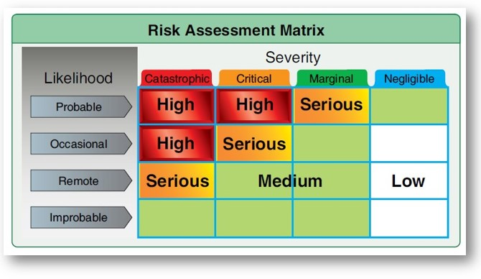
Fatigue Risk Management
Consider flying activities to be a part of your workday.
Plan a maximum of 12 to 14 hours per work period.
Schedule a 12-hour break between work periods.
Schedule a maximum of six consecutive work periods.
After six consecutive work periods schedule a 24 to 48-hour break.
Notes:
Consider flying activities to be part of your workday. (Click)
Plan a maximum of 12 to 14 hours per work period and schedule a 12-hour break between work periods. (Click)
Schedule a maximum of six consecutive work periods after which, schedule a 24 to 48-hour rest and recuperation period.
Next let’s consider stress.
(Next Slide)

Slide 12
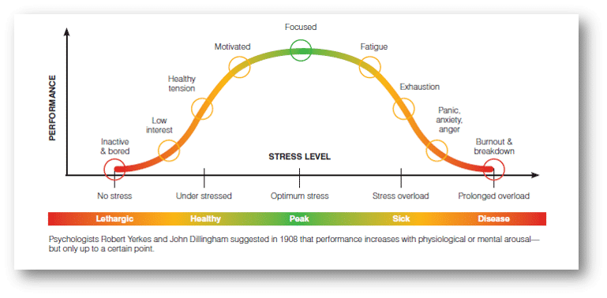
Stress
Notes:
Stress is a physiological and cognitive response to stressors - circumstances, events, and attitudes that shape our lives. Stress can build up over time, or it can be an acute reaction to pressures of the moment. When determining our fitness to fly, we need to consider our mental wellbeing as well as our physical state.
No one leads a stress-free life and indeed; moderate stress is healthy and enables us to do our best. But stress overload is another thing altogether. Our performance and health both suffer if we're overstressed. The trick is to maintain an optimum stress level - especially when engaged in complex and demanding activities..... like flying.
(Next Slide)

Slide 13
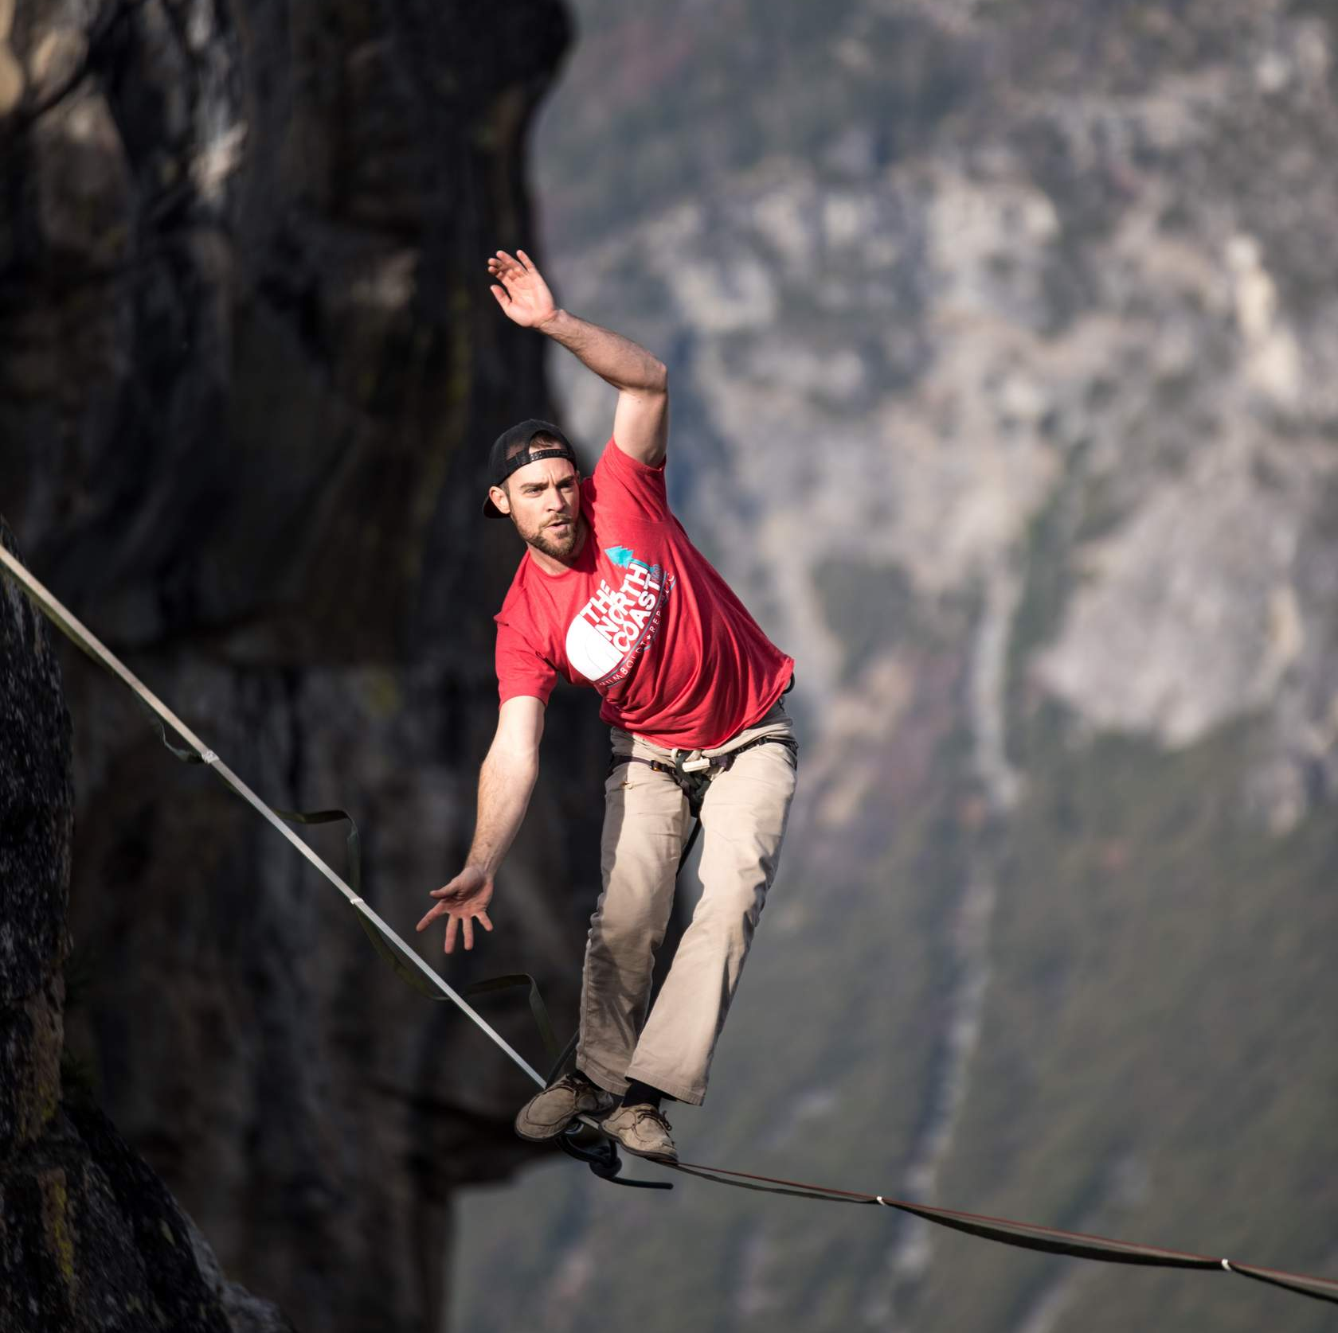
Chronic stress is dangerous.
anger, irritability, and anxiety
depression, and difficulty concentrating
fatigue, sleep disturbance & insomnia
headaches, & other aches & pains
upset stomach, indigestion, diarrhea
high blood pressure & heart disease
weakened immune system
low self-esteem, lack of confidence
feeling overwhelmed and/or out of control
feeling moody or sad
Notes:
Stress can be triggered by immediate, challenging or threatening situations, long-term background issues, or both. Response to stress depends on both stress intensity and length of exposure. Chronic (long-term) stress can become so routine that you are no longer aware of it – but it still causes harm.
Here are some symptoms of chronic stress. None of us would choose to live with these and yet, as we said, they can be so familiar that they just feel…. well…. Normal. Chronic stress is obviously dangerous but there’s another kind of stress that’s swift and deadly.
(Next Slide)

Slide 14

Acute Stress is deadly.
Sudden, extreme stress, such as when we are startled, may activate a deep-seated, reflexive fight or flight reaction that can lead us into a vortex of inappropriate action or no action at all.
Notes:
The human startle response is a deep-seated reflexive action initiated by the amygdala in the limbic system – the most ancient part of our brain. For eons it’s been a recipe for evolutionary success; a deep seated, reflexive reaction to stimuli that instantly prepares us to fight, or to run for our lives.
Running or fighting may not be helpful when coping with a rapidly developing aviation emergency. Success or failure will depend on how well we are prepared to deal with the emergency and all too often – how close we are to the ground when it happens.
Because the startle response is reflexive it’s virtually instantaneous – when we’re startled, we begin to respond before we have time to consider what we’re doing. In some cases, the Amygdala hijacks our thought processes, controlling our actions – often in inappropriate ways. Amygdala hijacks are immediate, overwhelming emotional responses to perceived threats unsupported by reasoned analyses of our situations. In worst case scenarios, we may find ourselves in a vortex of inappropriate action or unable to act at all. At the bottom of the vortex, we are spending all of our mental energy on staying alive with no capacity to reason our way out of our predicament.
(Next Slide)

Slide 15
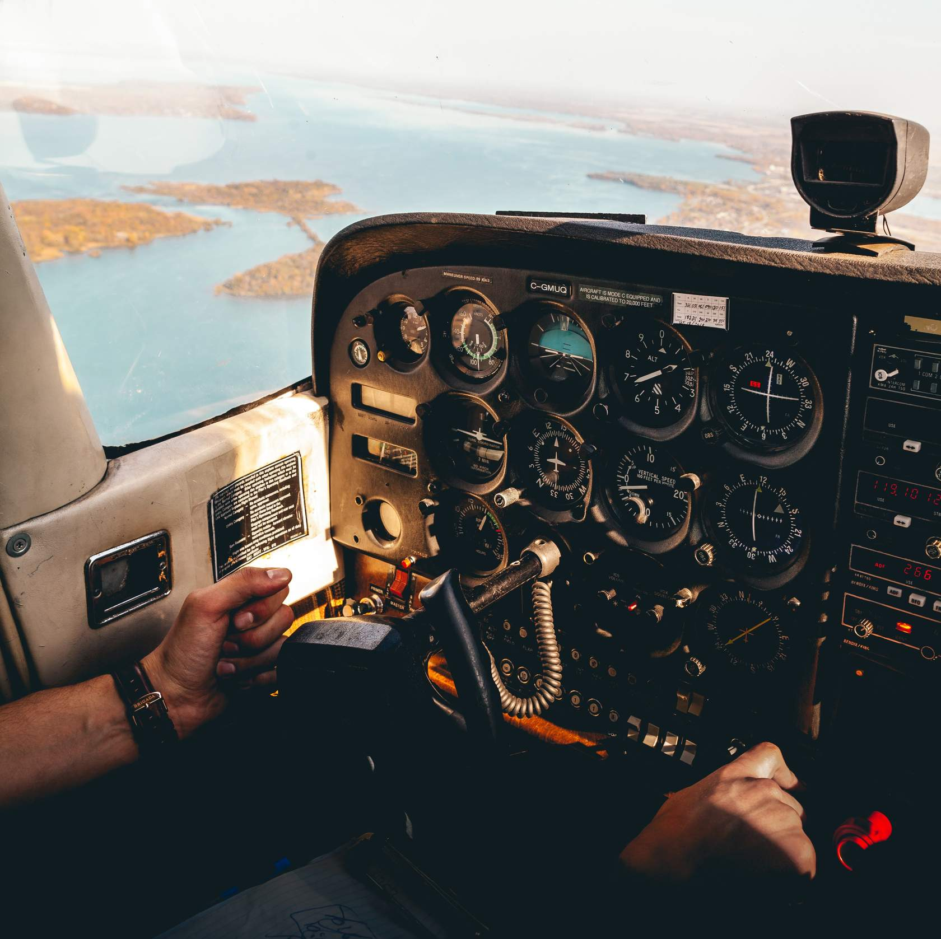
Coping with flying stress
Prepare
Anticipate
Plan
Brief
Manage flight resources
Take timely action
Notes:
The best way to cope with flying stressors is to prepare during pre-flight and take timely corrective action in-flight. . (Click)
Prepare - Know how to deal with normal and abnormal flight situations and practice so as to be able to manage them effectively. (Click)
Anticipate - Identify hazards and threats that could arise during flight even if they are unlikely. This will reduce the chance of inappropriate startle response. (Click)
Plan - Once you've identified hazards and threats plan how you will deal with them should they arise. Participating in a regular program of proficiency flying such as the FAA WINGS Pilot Proficiency Program will keep you flying at the top of your game. (Click)
Brief - Brief your plan to other crew members and/or passengers. Tell them what you will do if the flight does not go according to plan. Be sure to brief alternate destinations. This will preclude discussions or complaints while you are busy navigating to an alternate. (Click)
Manage flight resources - Make use of in-flight resources that reduce pilot workload. Autopilot use or sharing flying duties with another pilot can give you additional time to attend to navigation and communication tasks. That said - don't become over-reliant on automated systems. Practice to proficiency so that you will always be comfortable with assuming control.
Take timely Action - If things are not going according to plan, take action to correct them immediately. It's always best to address small problems early - before they become big ones.
There’s more to learn about stress in the Human Performance course module but let’s segue to our next topic with an interesting fact.
(Next Slide)

Slide 16

Stress, rest, and diet
Stress can lead to a poor diet and poor sleep.
Poor diet and poor sleep can increase stress.
Notes:
We can talk about human performance influencers in isolation, but the truth is that they’re interrelated in myriad fascinating ways.
Stress, work and recreational activities, rest, diet, and exercise all influence our wellbeing.
(Next Slide)

Slide 17

Diet, health, & wellbeing
A matter of balance…
Notes:
Diet, sleep, physical and mental health, stress, and exercise are linked. Each can influence the others in positive or negative ways. (Click)
As with many things in life, it comes down to a matter of balance.
(Next Slide)

Slide 18



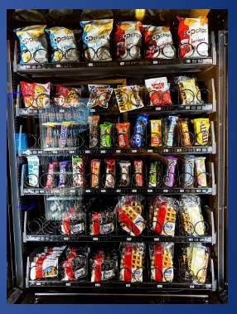

Not enough hours in the day…
Notes:
We've all had days when there just isn't enough time to accomplish everything we intend to do. In situations like these most of us will cut some things short in order to have more time for others. Unfortunately for us, this practice often results in shorter rest periods and skipped or rushed meals. Let’s consider this scenario:
You’ve spent the night in a hotel, and you plan a quick stop for coffee on the way to the airport. Now, what will you have for breakfast to go with that coffee? (Click)
You can grab a quick pastry & coffee at the airport café. Time: 10 minutes – less if you get your coffee to go. (Click)
The hotel coffee shop has a variety of breakfast options. Sit at the counter for the quickest service. Time: 20 minutes. (Click)
The FBO has a couple of vending machines. You can get coffee and something to eat there. Time: 5 minutes if the machines are working and you have the right change.
(Next Slide)

Slide 19
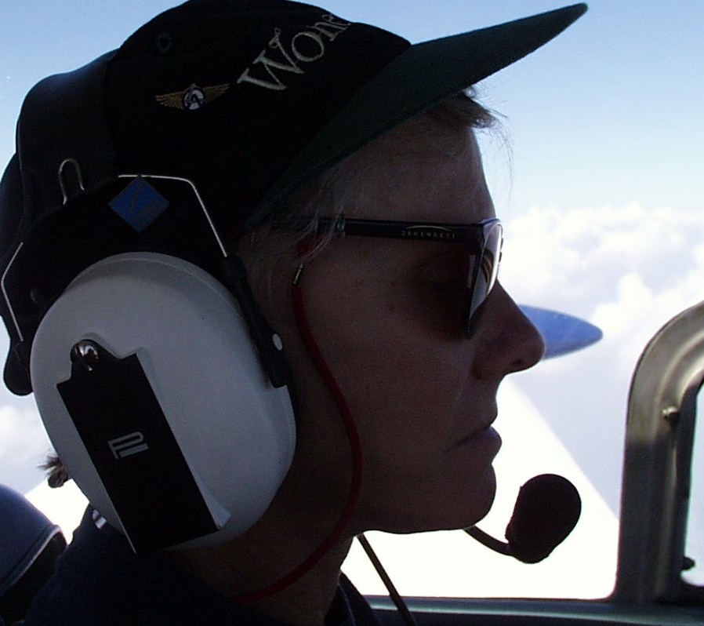
On the go…
Eat nourishing, balanced meals.
Plan for hydration needs before, during, and after flight.
Avoid sugary mochas, lattes, and sodas. Plain H2O is best
Notes:
Many of us have chosen the 5-minute options rather than a sit-down breakfast. We feel like we're being responsible to our schedules by eating what's convenient as quickly as we can. In the example from the previous slide, we save 15 minutes by grabbing a sweet roll or snack to go with our coffee. But is that the best choice to make?
The jolt of sugar and caffeine will get us going all right. But how many of us have felt that sinking feeling when we come off the sugar high in less than an hour - just about the time we're leveling at our cruise altitude? (Click)
Even if it entails waking 15 minutes early, it's a best practice to take the time to eat a balanced breakfast that will nourish us for more than an hour. (Click)
And plan for hydration needs before, during, and after flight. Don’t wait until you’re thirsty. Thirst is one sign of dehydration. (Click)
Eschew the mochas, lattes, and sodas. Plain water is the best hydration source for human performance.
(Next Slide)

Slide 20

Nuts
Dairy products & eggs
Fruit & vegetables
Olive oil
Whole grain foods
Lean meat, poultry, & fish
Notes:
Studies have indicated that a Mediterranean-style diet can support weight loss, lower the risk of heart disease, cancer, and Type 2 diabetes, and increase life expectancy. Mediterranean diets feature (Click)
Fruits and vegetables - that contain many bioactive compounds that have antioxidant and anti-inflammatory properties, and that help protect against cancer. (Click)
Lean meat, poultry, and fish. Oily fish such as salmon, tuna, and mackerel contain omega-3 fatty acids that have a wide range of health benefits and are often lacking in many diets. (Click)
Whole grain high-fiber foods such as whole meal bread, pasta, and brown rice. (Click)
Dairy products and eggs. Milk, cheese, and yogurt that contain live active cultures are good for bowel health. Eggs contain a wide range of vitamins, minerals, and high-quality proteins. They’re a better choice than sugary breakfast cereals and pastries. (Click)
Nuts – they’re a good choice for snacks. They contain lots of fiber, and a good source of protein, and the slow-burn oils they contain boost energy. (Click)
And Olive oil – One of the healthiest fats, it contains a range of polyphenols and antioxidants that are good at reducing inflammation.
(Next Slide)
Background: The Mediterranean Diet: An Update of the Clinical Trials – National Library of Medicine
https://www.ncbi.nlm.nih.gov/pmc/articles/PMC9317652/
Diet Review: Mediterranean Diet - Harvard University
https://nutritionsource.hsph.harvard.edu/healthy-weight/diet-reviews/mediterranean-diet/

Slide 21



Balance
Variety
Moderation
Notes:
You can sum up the basics of healthy eating in three words: (Click)
Balance – Balance your weight by matching food intake to physical activity. The amount of energy we need is different for everyone. Eat mostly fresh whole foods and plenty of vegetables. Avoid processed and convenience foods. Most have too much added sugar and salt. (Click)
Variety – Try to eat from all the food groups each day. If possible: vary the food in each group daily. It will keep meals interesting and provide a broad range of nutritional benefits. And avoid fried foods. They may contain harmful trans-fat from cooking oil. (Click)
Moderation – Practice portion control. It’s easy to over do on restaurant and takeout fare. Enjoy food and drink in moderation. Limit treats and alcohol. They tend to be high in calories and low in nutrients. Be careful while traveling. Fast foods that are readily available on the road are less healthy and hotel buffets can encourage overeating.
(Next Slide)

Slide 22


Alcohol and drugs
Notes:
We all know that alcohol and flying don’t mix. Alcohol affects the central nervous system, slowing down the messages between the brain and body. It inhibits concentration and coordination and slows our ability to respond to unexpected situations. Alcohol impairs judgement and leads to behavior that can contribute to or cause accidents.
We’re accustomed to a wide range of prescription and over-the-counter (OTC) drugs that are useful in treating disease, combating infection, and easing the symptoms of everything from allergies to headaches and the common cold. But pilots have a special responsibility to ensure that whatever medicines they are taking, even those that are prescribed by doctors, will in no way compromise the safety of flight. Few pilots are qualified to make that determination. For that, we need to consult with experts who are.
(Next Slide)

Slide 23

Consult your AME
Prescription & OTC effects & interactions
Declare all medications
Follow advice
This Photo by Unknown Author is licensed under CC BY
Notes:
If you’re thinking of your Aviation Medical Examiner, you’re right. AMEs are especially trained in pilot medical certification of course, but they’re also experts on prescription and OTC drugs and how they may interact with each other. If you have a new prescription or therapy or you’re thinking of trying an OTC medication, it’s best practice to consult your AME. If flying on that medication is contraindicated, your AME may be able to suggest some alternatives. If not – you’ll get a good idea of how long you’re going to be grounded and what you’ll need to do to get back in the air. (Click)
We shouldn’t have to say this but it’s essential that you declare all the prescription and OTC products you’re taking. Your AME must have all the information to provide you with the best advice. (Click)
And of course, follow that advice for best results.
Before we leave the topic, here’s two more excellent aviation medicine references
(Next Slide)

Slide 24


The Civil Aerospace Medical Institute (CAMI)
Aerospace Medical & Human Factors Research
Aerospace Medical Education Training Programs
Aviation Medicine
Aviation Medical Examiners (AMEs)
Airman Education Programs
Aeromedical Safety Brochures
https://bit.ly/3HV28BW
Notes:
The Civil Aerospace Medical Institute, or CAMI, conducts aerospace medical and human factors research projects and they also produce and distribute high-quality medical education and training programs for pilots and Aviation Medical Examiners. You can access CAMI’s excellent series of Aeromedical Safety Brochures from their home page by navigating to the URL or scanning the QR code on screen.
Presentation note: Pause briefly to allow audience to copy and scan – then:
Now let’s turn to our last Human Performance topic – Exercise.
(Next Slide)

Slide 25


FAA Safety Briefing
January/February 2022 Issue
https://tinyurl.com/47zsv8ky
Notes:
We also recommend this edition of FAA Safety Briefing Magazine that’s entirely devoted to Aerospace Medicine and Pilots. Navigate to the URL or scan the QR code on screen for your copy.
Presentation note: Pause briefly to allow audience to copy and scan – then:
(Next Slide)

Slide 26

Exercise
Notes:
The benefits of physical activity are many but it's often difficult for us to find the time to exercise. This is especially true for pilots who fly irregular schedules or who are frequently away from home. But if you're resolved and resourceful, you can find a way to exercise even when you're travelling. Here's why you should.
(Next Slide)

Slide 27
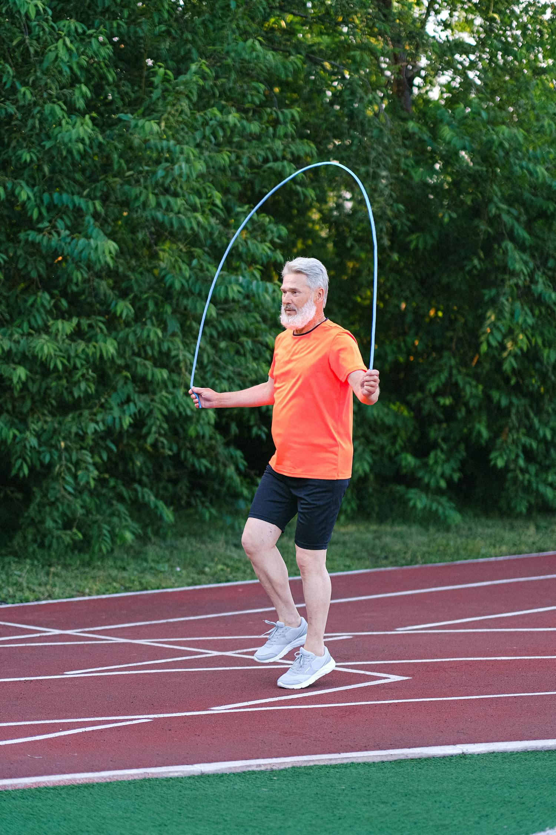
Physical activity benefits…
Improved memory and brain function
Protection against many chronic diseases
Weight management
Lower blood sugar and improved heart health
Reduced fatigue and improved sleep
Increased muscle strength
Improved balance.
Notes:
The benefits of exercise are well documented. One that isn’t mentioned here is the sometimes described as “euphoric” feeling you get after a workout. Exercise produces a rush of “happy hormones” known as endorphins that not only diminish our perception of pain but also promote a positive and energizing outlook on life.
I know what some of you are thinking, “I wish I had time to exercise but there’s so much I have to do, I just can’t find the time.”
(Next Slide)

Slide 28


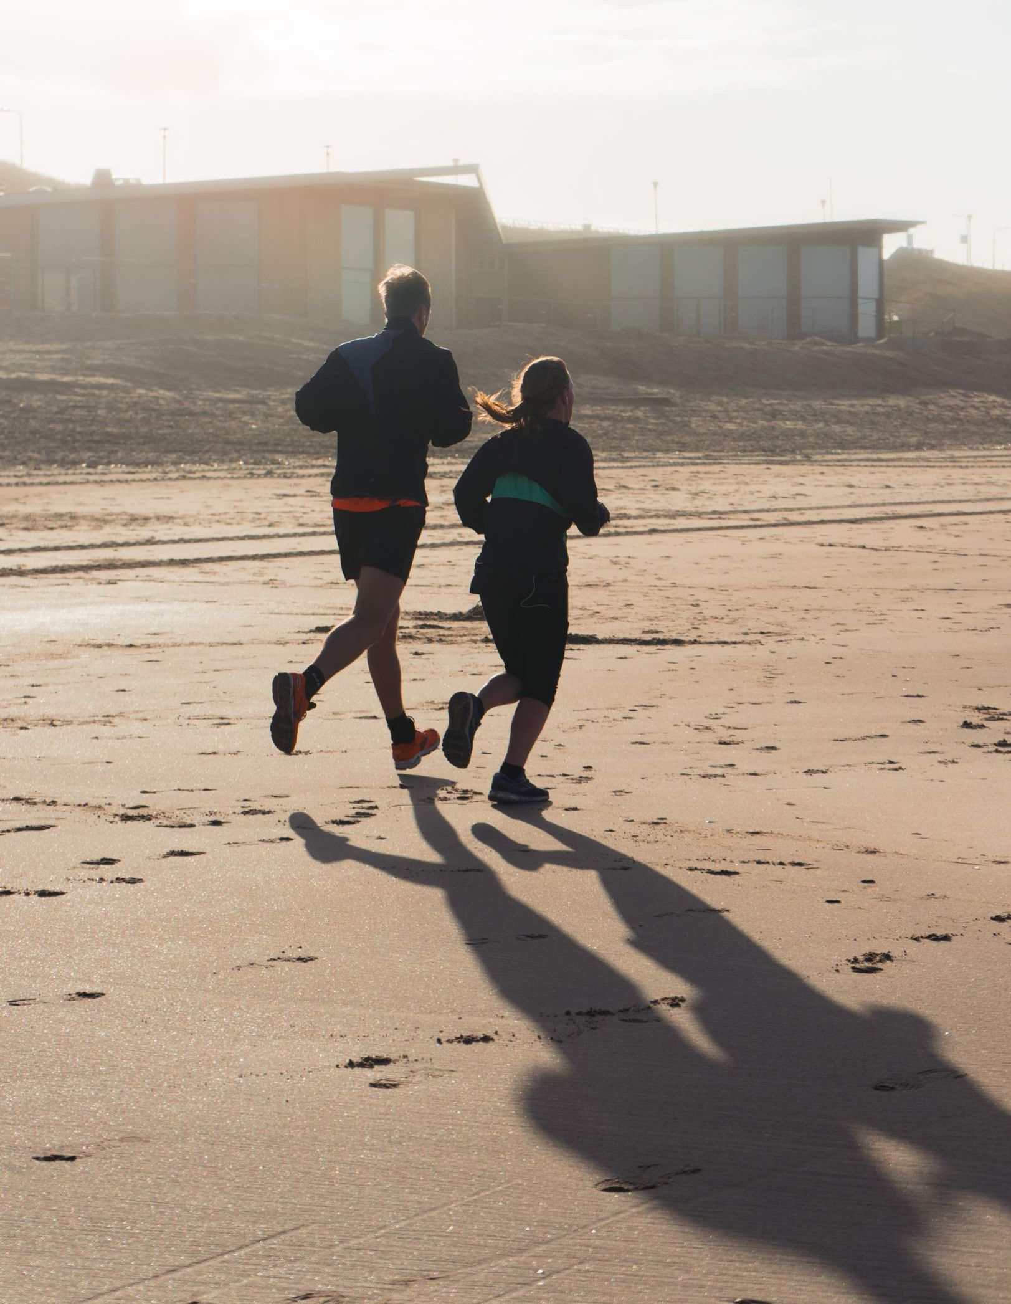
30 minutes per day…
Notes:
Do you have 30 minutes each day to spend on yourself? Many of us would say no. Our lives are so full that carving out 30 contiguous minutes may at first seem impossible. But what if you were to go to bed a half hour earlier and rise a half hour earlier than you usually do? That might give you time to exercise before work or before dinner. Let’s face it. There’s not much on TV at those times and surfing the web? Well, we can really do that anytime and losing a half hour of computer time probably wouldn’t hurt any of us.
The benefits from exercising are so profound that perhaps we should add another “E” to a familiar Pilot’s Checklist.
(Next Slide)

Slide 29

I’m Safe Checklist
I – Illness
M – Medication
S – Stress
A – Alcohol
F – Fatigue
E – Eating, Emotion
& Exercise
Notes:
The I’m Safe checklist has been around for a long time but it’s a good idea to review it here. The checklist is designed to answer six questions. (Click)
Am I feeling ill today? If the answer is yes, it’s probably not a good day to fly or perhaps even drive a car. (Click)
Am I taking any prescription or over-the-counter medication that could compromise my ability to fly? Many medicines caution against operating machinery and aircraft certainly qualify as complex machines. (Click)
Am I under unusual stress today? We all cope with stress each day and a little stress has been shown to improve human performance. But, if we’re under moderate to heavy stress our performance will definitely not be our best and it may even be dangerous. If, for instance, we are flying to a very important meeting that cannot be re-scheduled or delayed, the importance of the mission could compromise our pre- and in-flight decision making. (Click)
Have I ingested any alcohol – in the previous twenty-four hours? I know the rule says eight hours, but lingering affects can persist. (Click)
Am I adequately rested before this flight? And just as important, will I become fatigued during the flight? We may be fine for the short drive home after a long day at work, but embarking on a flight perhaps at night, may be a greater challenge than we should accept. Getting a good night’s sleep and starting in the morning may well be the safer choice. (Click)
Am I adequately nourished and hydrated? And am I emotionally ready for this flight? We like to say we leave our problems on the ground when we fly but, for most of us, that’s not really true. If we’re worried or even very happy about something we may dwell on the topic at the expense of our flight duties, or our decision making may be compromised. (Click)
And finally, am I exercising regularly?
(Next Slide)

Slide 30
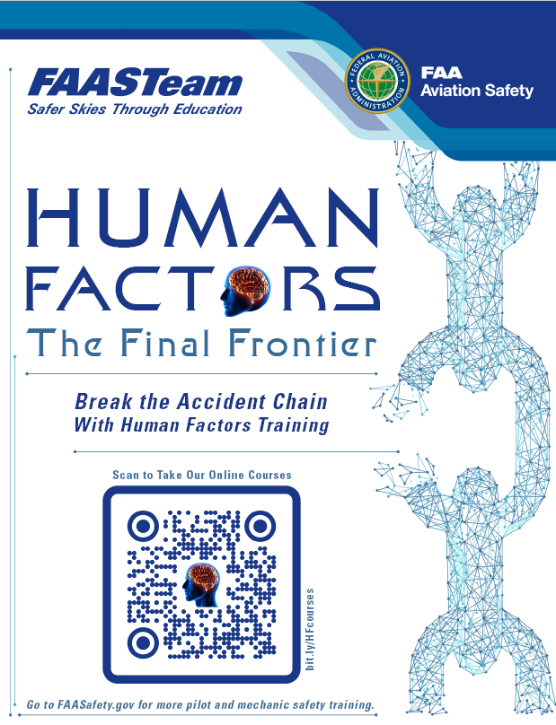
Begin (or continue) your Human Factors journey here
http://bit.ly/HFcourses
Notes:
There’s much more to learn in Module 3 and the rest of your FAASTeam Human Factors for Pilots courses. We encourage you to explore the series. Navigate to the URL or scan the QR code on screen for a FAASTeam Human Factors course catalog that features direct links to each of the courses.
(Next Slide)

Slide 31

Thank you!
Aviate - Reduce levels of automation to a point where you are comfortable in managing your flight path.
Navigate - Manage your flight path to ensure you are clear of terrain, obstacles, and air traffic.
Communicate - With your aircraft under control in safe airspace; communicate and act on your intentions.
Notes:
Well, that concludes this presentation. Thanks very much for your participation. We applaud your dedication to excellence in aviation safety education and we invite you to continue your journeys to excellence in the FAA WINGS Pilot Proficiency Program.
Please accept our best wishes for safe flying and remember to always, (Click)
Aviate - Maintain aircraft control and reduce levels of automation to a point where you are comfortable in managing your flight path. (Click)
Navigate - Manage your flight path to ensure you are clear of terrain, obstacles, and air traffic. (Click)
Communicate - With your aircraft under control in safe airspace; communicate and act on your intentions.
(Next Slide)

Slide 32
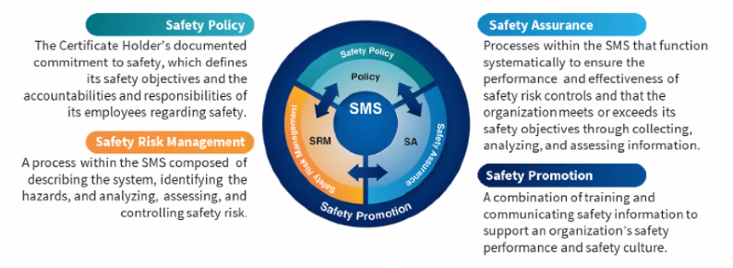

Safety Management Systems (SMS) Coming to General Aviation
Safety Management System (SMS) | Federal Aviation Administration (faa.gov)
Notes:
Safety Management Systems are a set of policies and processes that can increase the safety and efficiency of any flight operation. And FAA is bringing SMS to General Aviation. You may have heard of SMS but thought it was only for large organizations but actually, SMS can be scaled to fit any operation large or small.
There are 4 major components to a Safety Management System (Click)
Safety Policy – a documented commitment to safety that runs from the head of an organization to its newest member. (Click)
Safety Risk Management – a process that identifies hazards within an operation, determines to what extent an identified hazard may impact flight safety, and controls the risk of occurrence to an acceptable level. (Click)
Safety Assurance – By collecting and analyzing information derived from safety performance data Safety Assurance ensures the performance and effectiveness of Safety Risk Controls. (Click)
Safety Promotion communicates safety information and commitment throughout the organization. (Click)
You can find more information about Safety Management Systems at the URL on the Screen.
(Next Slide)

Slide 33

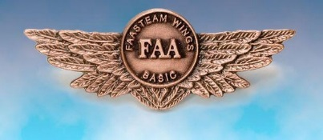
Questions?
Notes:
Presentation Note: You may wish to provide your contact information and main FSDO phone number here. You can also add WINGSPro contact information.
Modify with your information or leave blank.
(Next Slide)

Slide 34
The National FAA Safety Team Presents
Topic of the Month - October
Human Performance
Notes:
2024/09-10-314(I)PP Original Author: John Steuernagle; POC Kevin Clover, National FAASTeam Program Manager (Operations), Office 562-888-2020.
Presentation note: This is the title slide for FY2026 Topic of the Month – October – Human Performance.
Script - We have included a script of suggested dialog with most slides. The script will always appear in a non-italic font. Presenters may read the script or modify it to suit their own presentation style. See template slides 3 and 4 for examples of a slides with script.
Presentation Instructions - (stage direction and presentation suggestions) will be preceded by a Bold header: the instructions themselves will be in Italic fonts. See slides 2 for an example of slides with Presentation Instructions only.
Program control instructions - will be in bold fonts and look like this: (Click) for building information within a slide; or this: (Next Slide) for slide advance.
Background information - Some slides may contain background information that supports the concepts presented in the program. Background information will always appear last and will be preceded by a bold Background: identification.
The production team hope you and your audience will enjoy the show. Break a leg!
(Next Slide)

